Slide 1


The Economics of Point of Care Tests
Lesong Conteh
Wellcome Trust Career Development Award Investigator
Associate Research Professor, LSE
Reubens College, Oxford, UK 1 July 2025

Slide 2
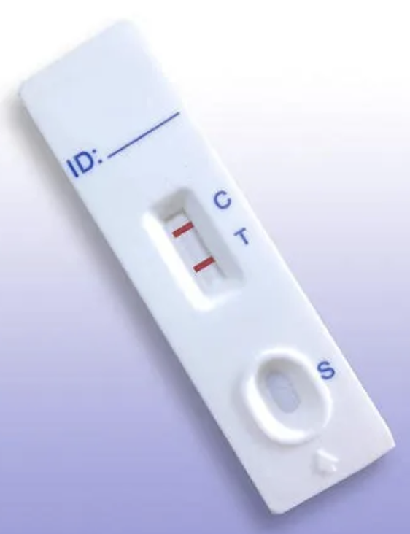
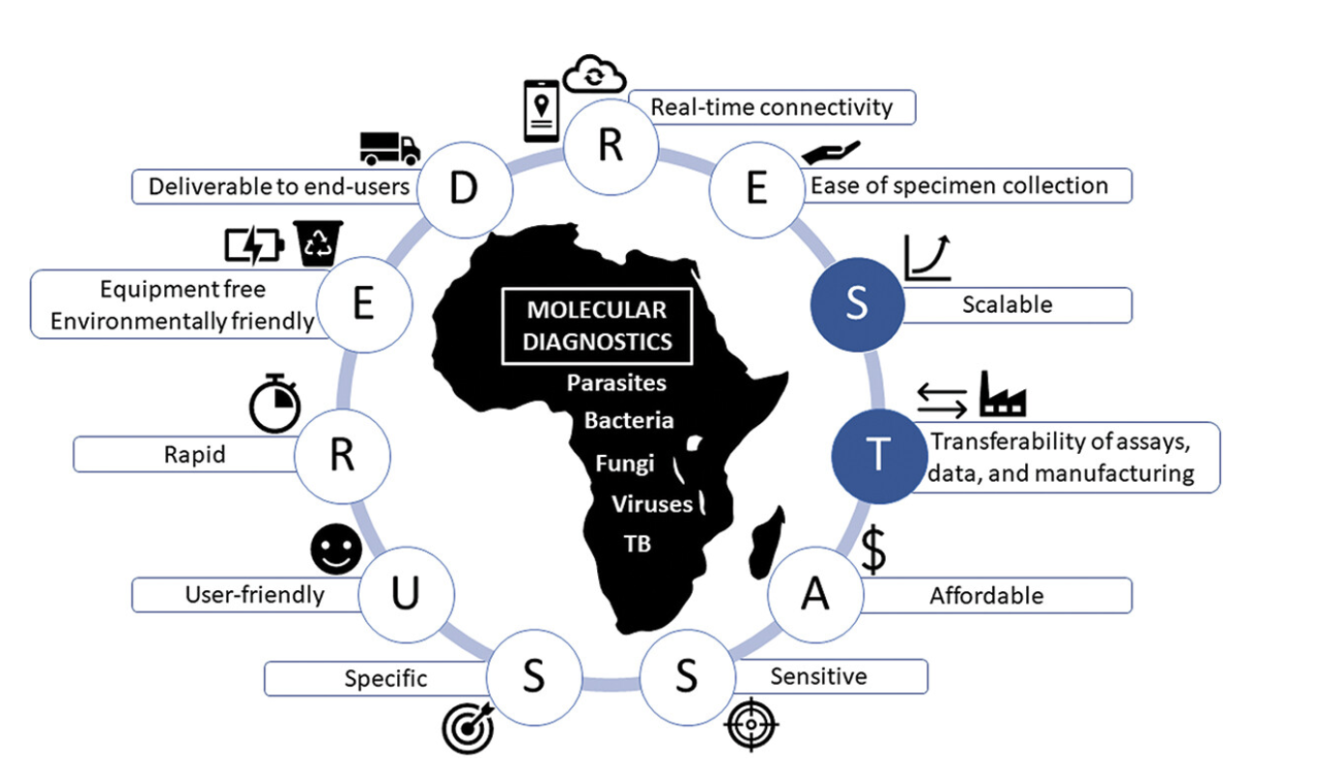
Why Point of Care Tests (POCTs)?
Economics, health systems & policy knowledge gaps
Multi-country research across Africa: from treatment to diagnostics
Close-to-community research: access & equity considerations
Baldeh M. et al (2023) Expert Review of Molecular Diagnostics, 24(3), 153–159

Slide 3


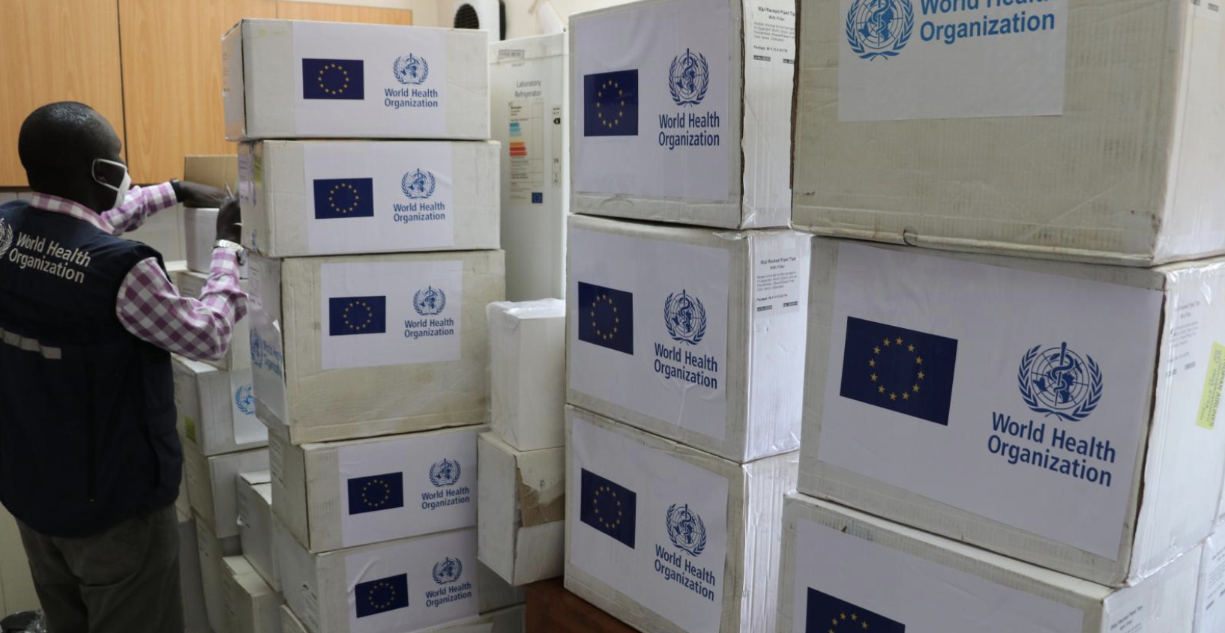
The need for comprehensive economic evidence
on the impact of POCTs
Microeconomic
individuals
and health facilities
Mesoeconomic
national and community
level health system
Macroeconomic
national impact beyond
the health sector

Slide 4


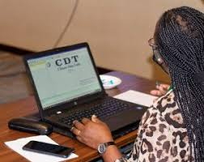
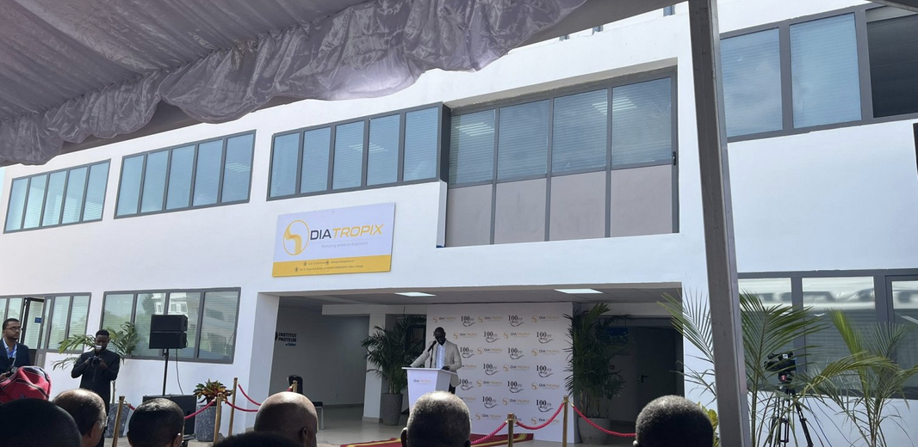
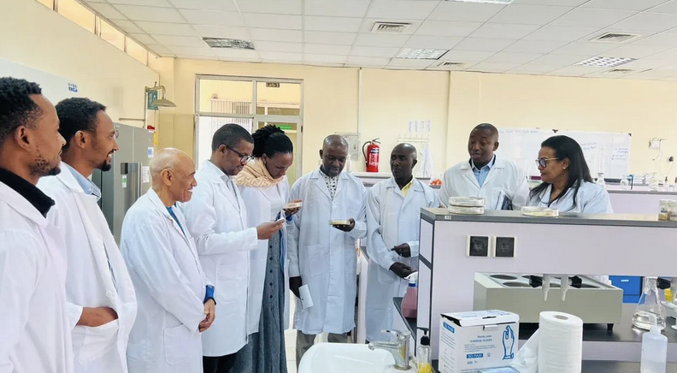


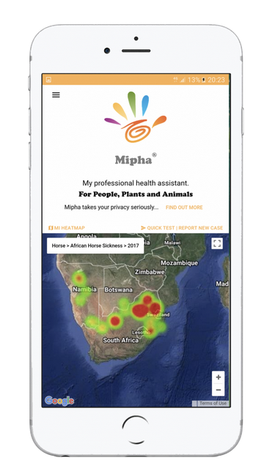



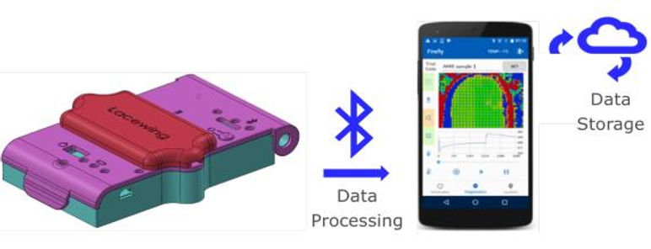


Collaborators & Countries
Institute Pasteur de Dakar (IPD),
& DIATROPIX, Senegal
CDT-Africa
University of Addis Ababa,
Ethiopia
Senegal
Sudan
Burkina Faso
Ethiopia
Kenya
Gabon
Mozambique
Namibia
Lesotho
Liselo Labs &
National University of Lesotho
Lesotho
Notes:
A New Era in the African Market for Diagnostics

Slide 5
Micro economics:
Individual level

Slide 6

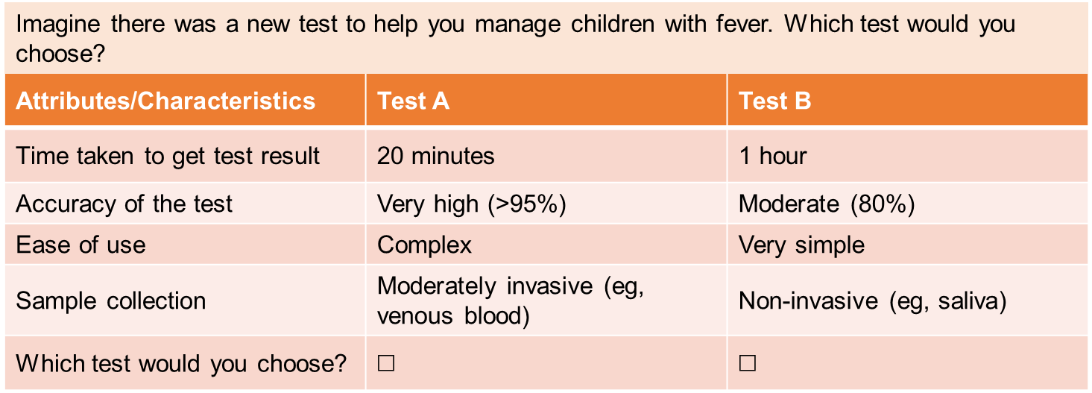
(1) DCEs: Understanding individual preferences
What is a DCE? A discrete choice experiment is a survey composed of choice sets. Choice sets are a series of questions where the respondent must choose between two or more alternatives (participants repeatedly choose between tests with varying features)
Alternatives are defined by their characteristics (attributes)
Individuals’ choices depend on the evaluations they make of those characteristics
Courtesy of Dr Bryony Simmons

Slide 7
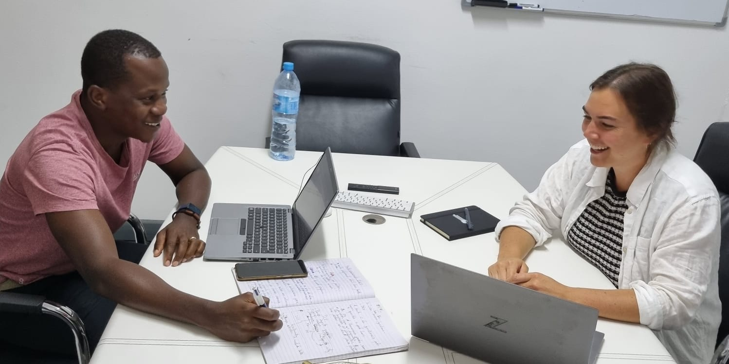
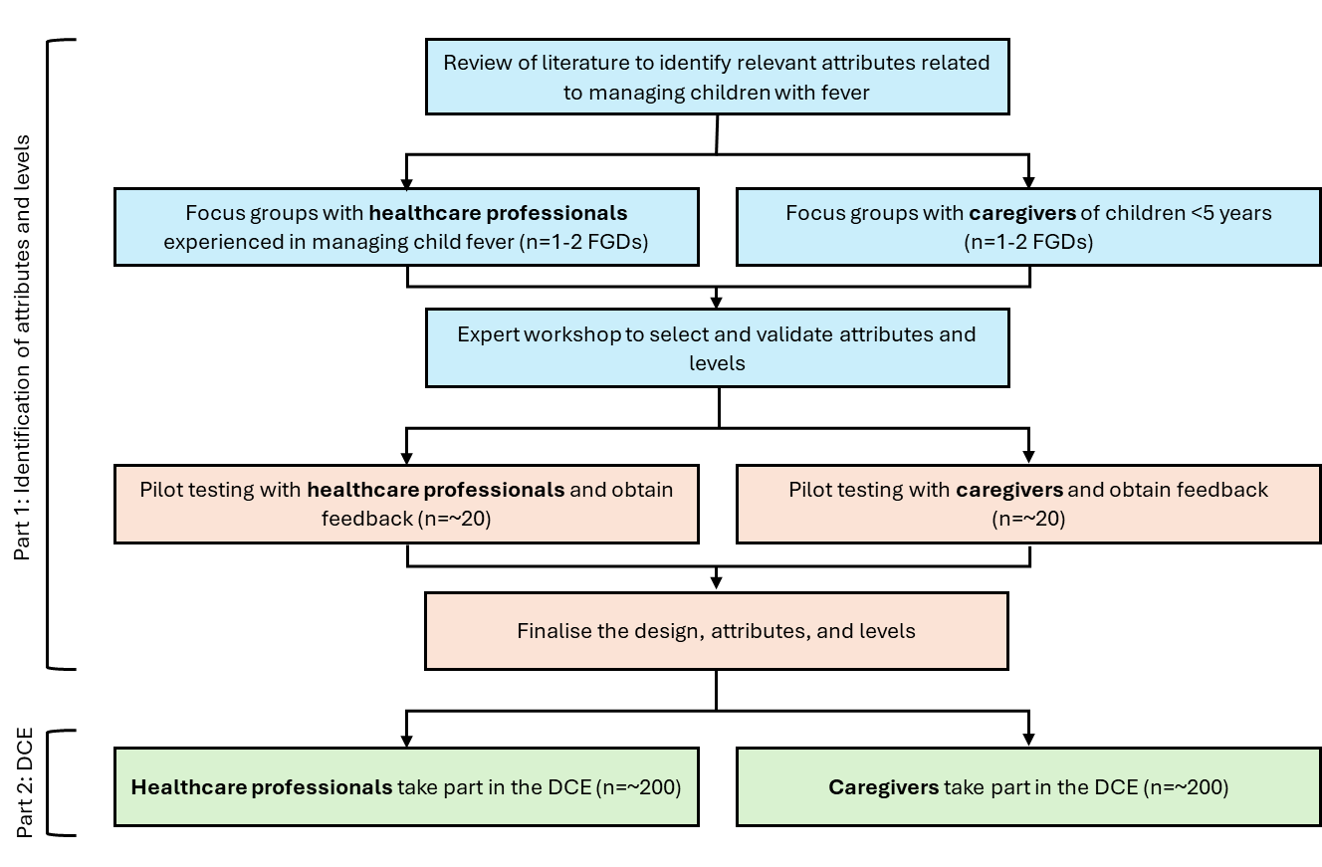
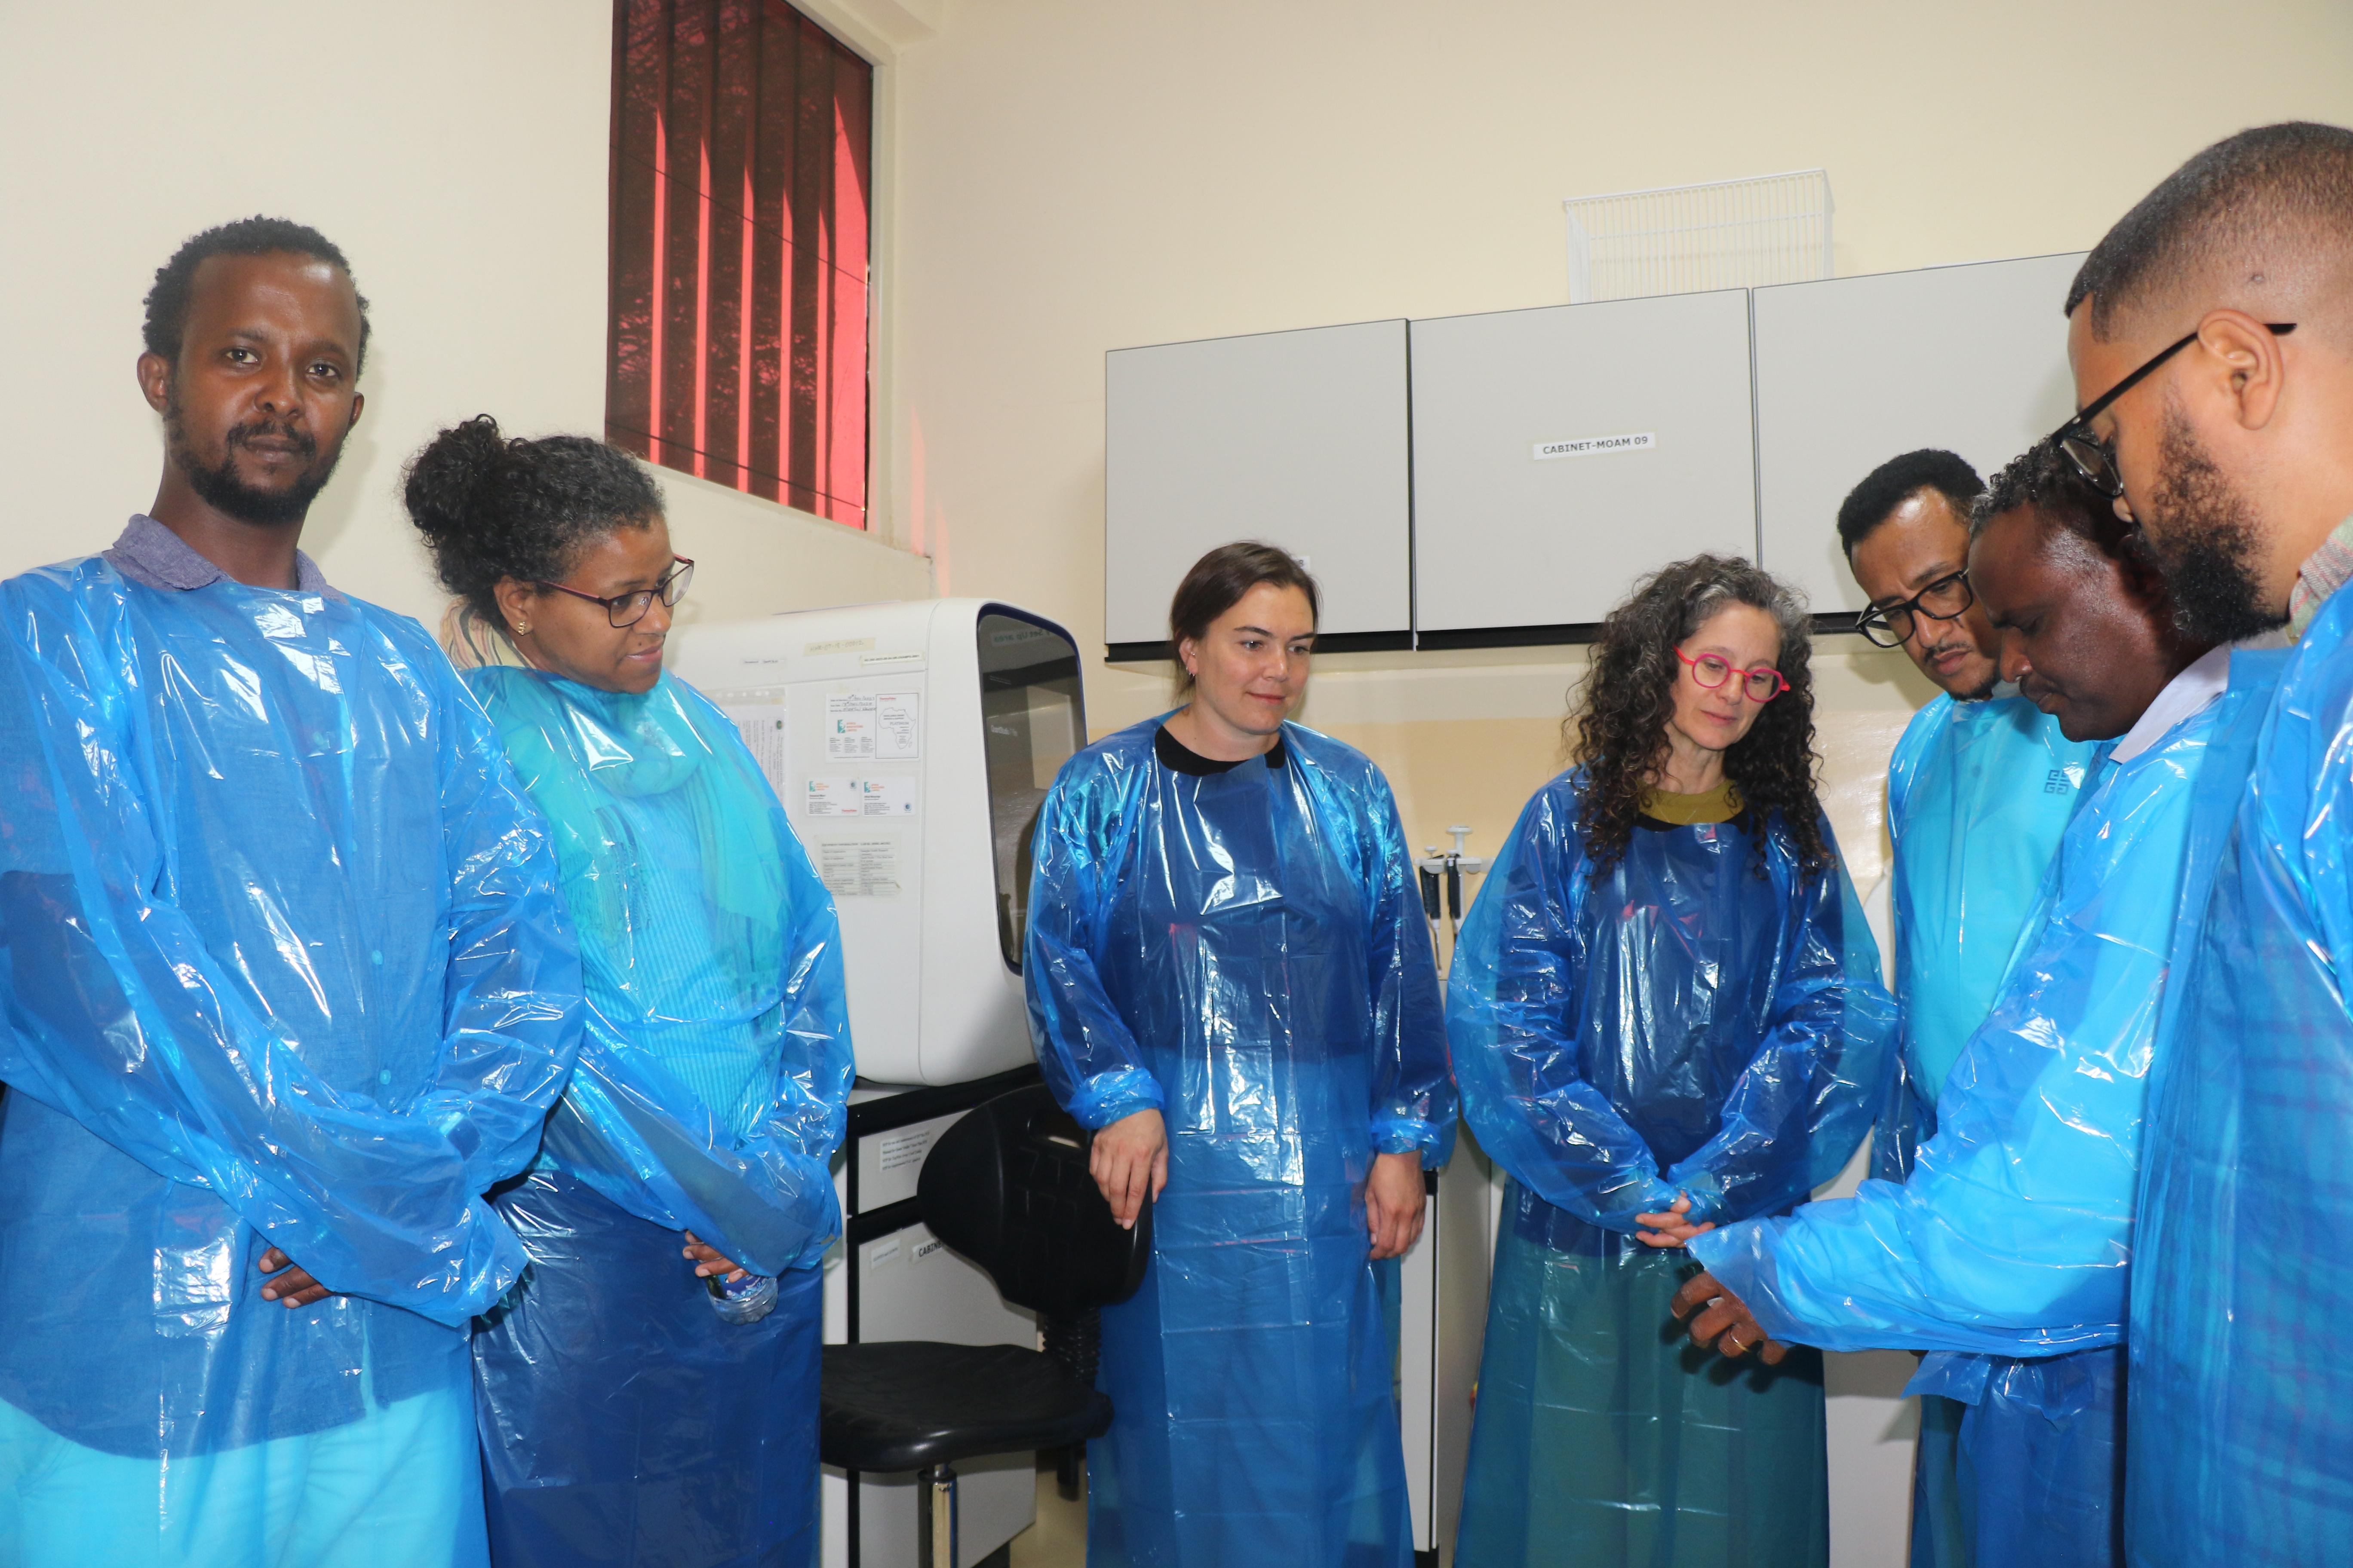
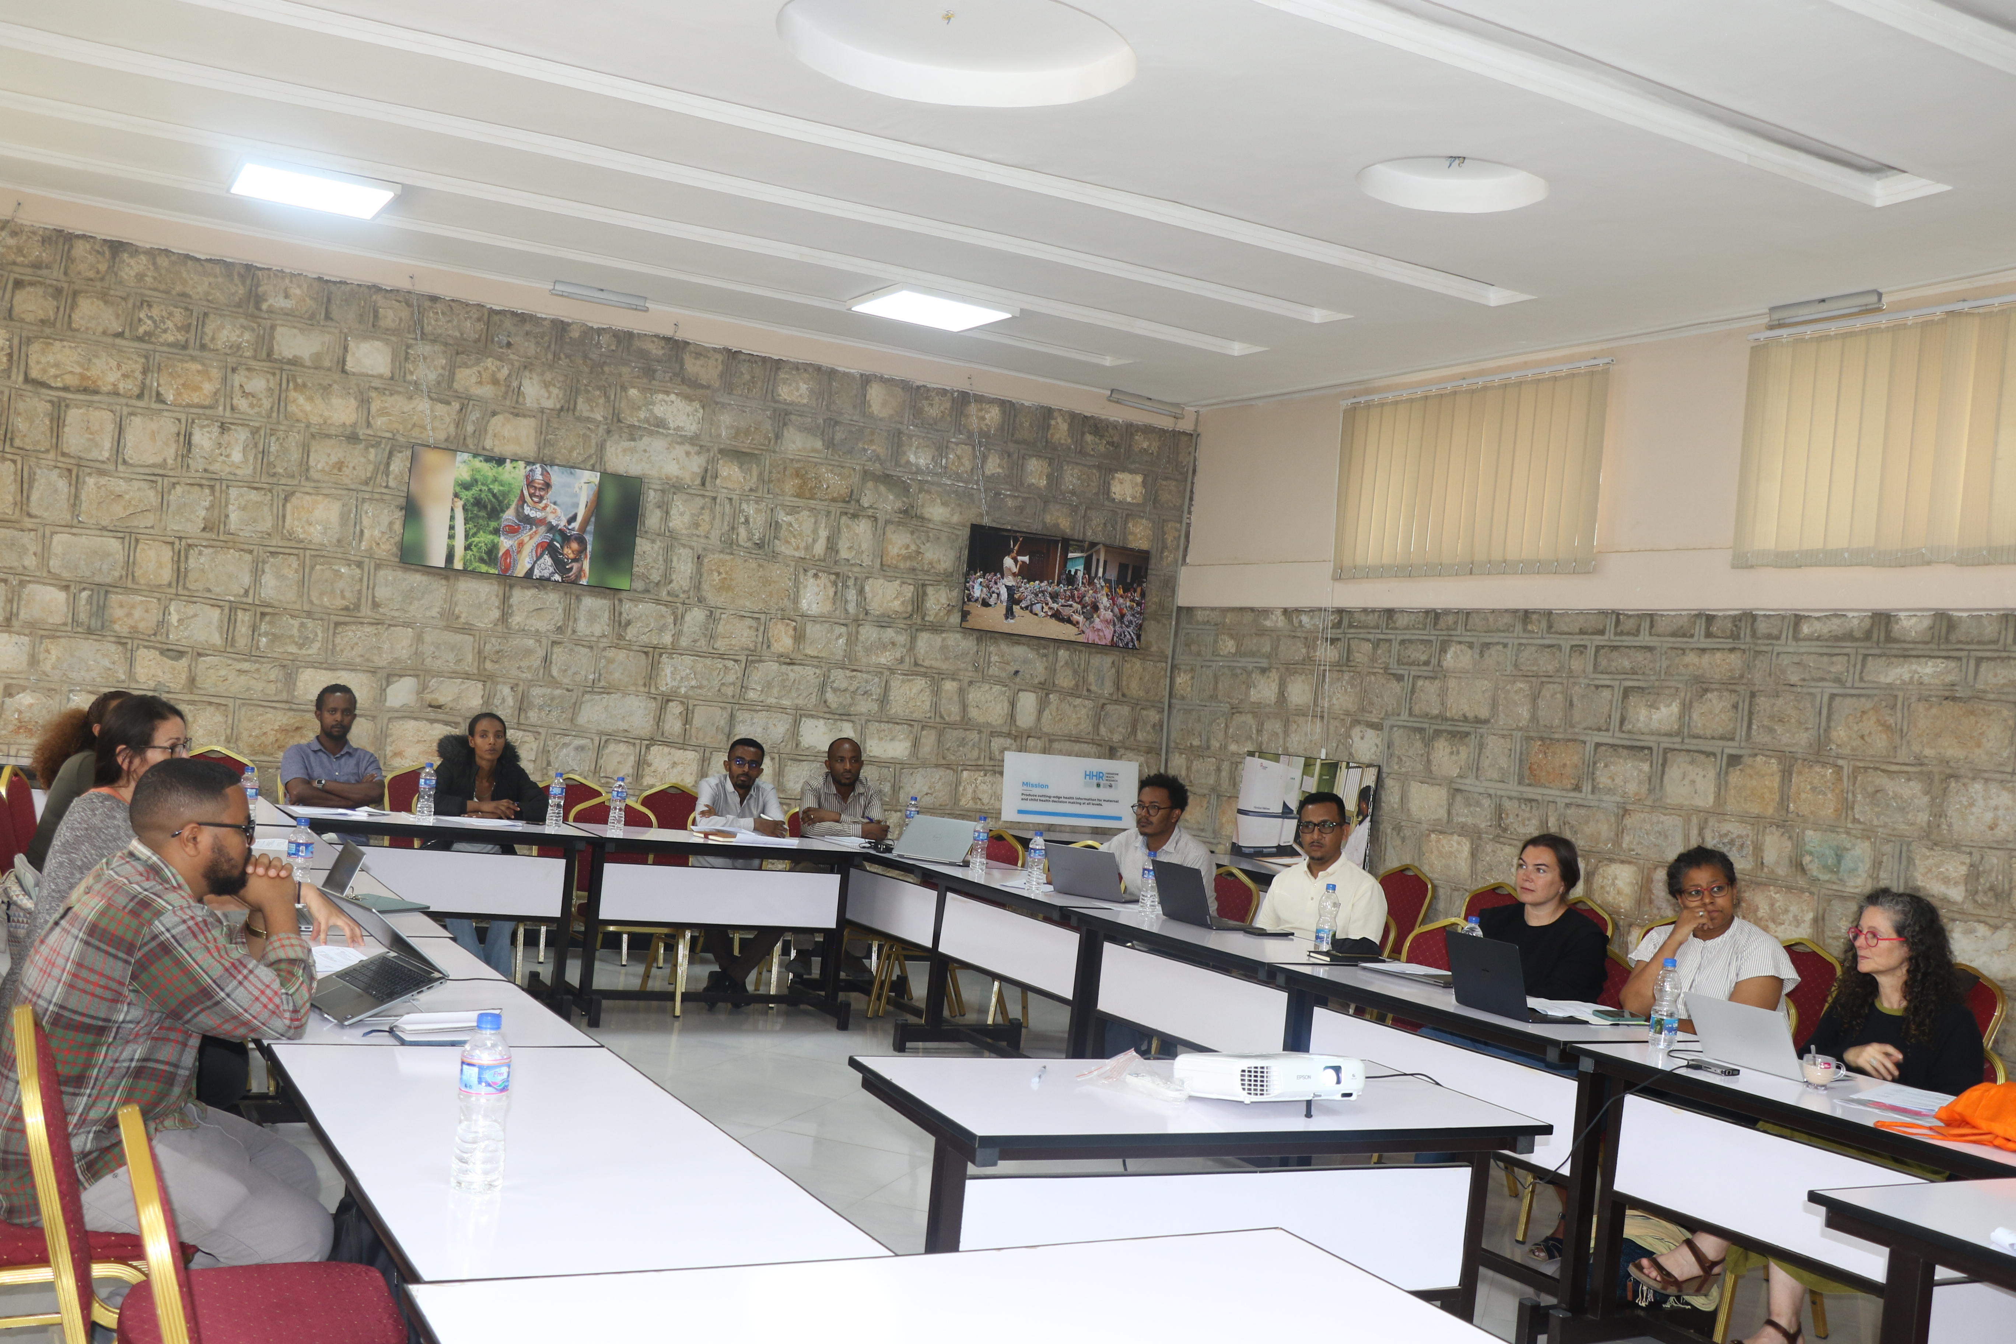
DCE Study Design
Objective: Quantify healthcare provider and caregiver preferences for test attributes to inform development and adoption
CISM, Maputo
Mozambique,
June 2025
Harar Health Research Unit, Ethiopia, June 2025
Research led by Dr Bryony Simmons
Notes:
Two-phase approach:
Formative: Literature review, FGDs, expert workshop, and piloting to define attributes and levels
Quantitative DCE: providers + caregivers
Estimate utilities for each attribute level
(ie, what attributes matter most to providers and caregivers)
Identify trade-offs and relative important of attributes
(eg, slow result in exchange for non-invasive sample)
Explore preference heterogeneity
(eg, by cadre, location, experience, etc)
Findings from FGDs also to be analysed by SBS team

Slide 8

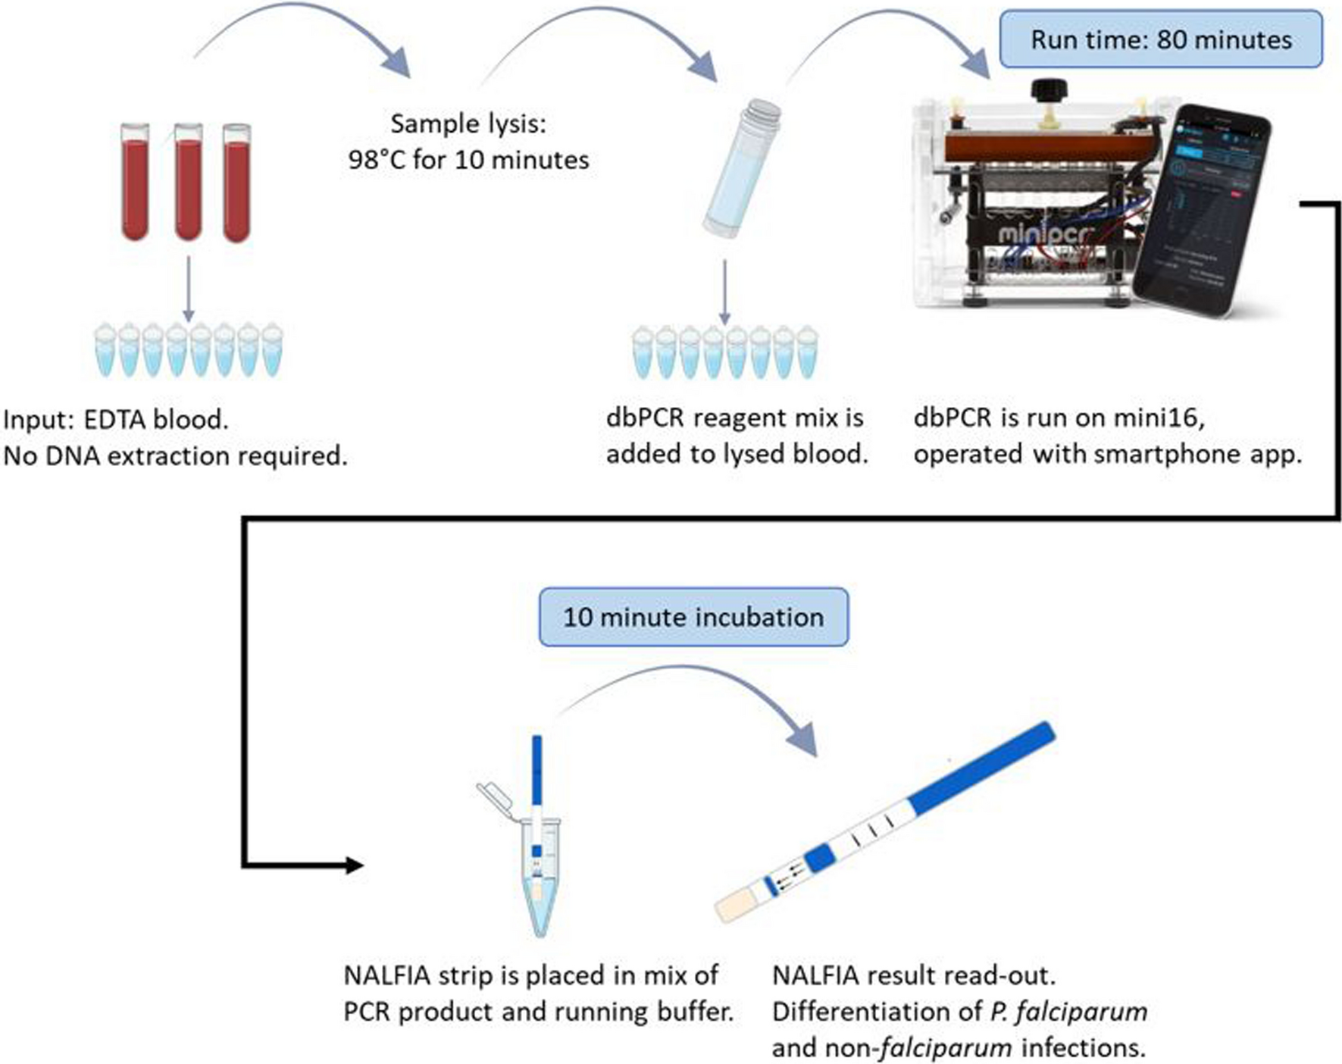
(2) Willingness to Pay
To understand what value DIAGMAL study participants and communities attach to the new product:
within and across country analysis
To estimate the expected demand (stated preferences) for the new tool
van Dijk, N.J., et al. Laboratory evaluation of the miniature direct-on-blood PCR nucleic acid lateral flow immunoassay (mini-dbPCR-NALFIA), a simplified molecular diagnostic test for Plasmodium.Malar J 22, 98 (2023)
Notes:
Country analysis including personal and clinical factors

Slide 9
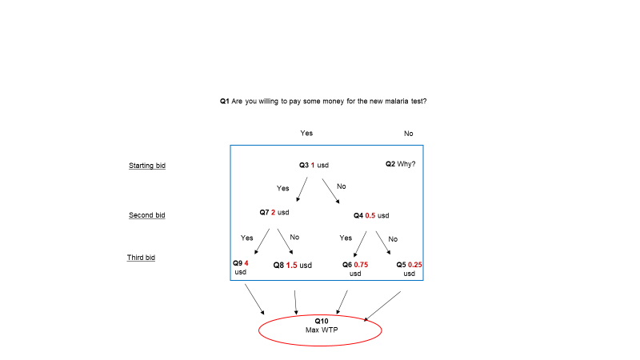
WTP scheme

Slide 10

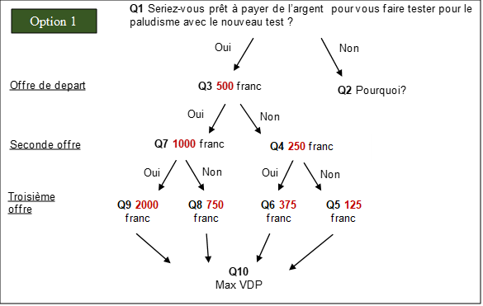
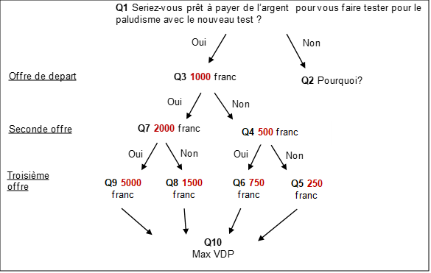
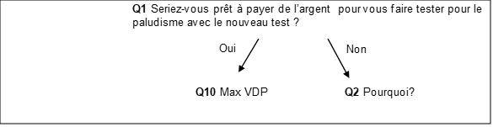
Burkina Faso: Willingness to Pay

Slide 11
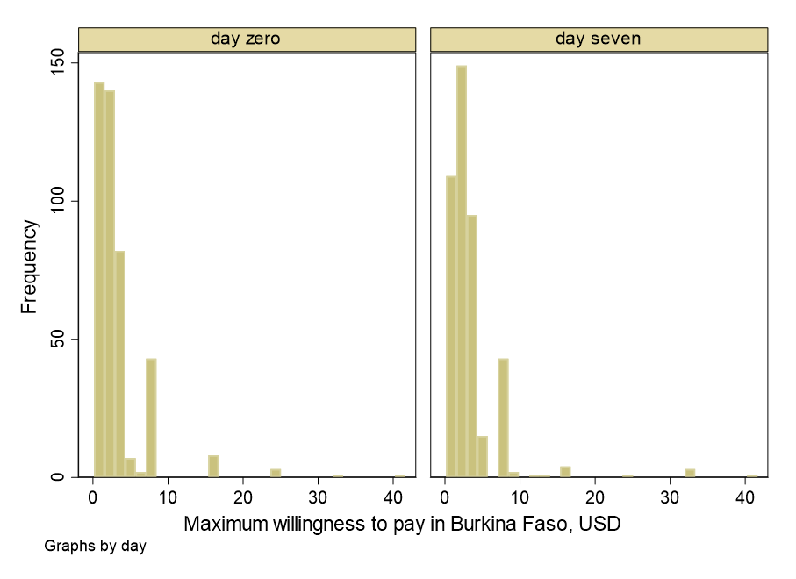
Burkina Faso preliminary results
 | Obs | Mean | Stand Dev | Max | Min
Day 0 | 430 | 3.00 | 4.07 | 40.25 | 0.16
Day 7 | 424 | 3.18 | 4.17 | 40.25 | 0.16
Courtesy of Dr Elisa Sicuri
Notes:
Burkina Faso is reported as an example. In BF WTP data are available at both Day 0 and Day7 and at Day7 there is a slight increase in comparison with Day0
I am not presenting Sudan and Ethiopia as nothing changed from last presentation

Slide 12
Meso economics:
Health Systems

Slide 13
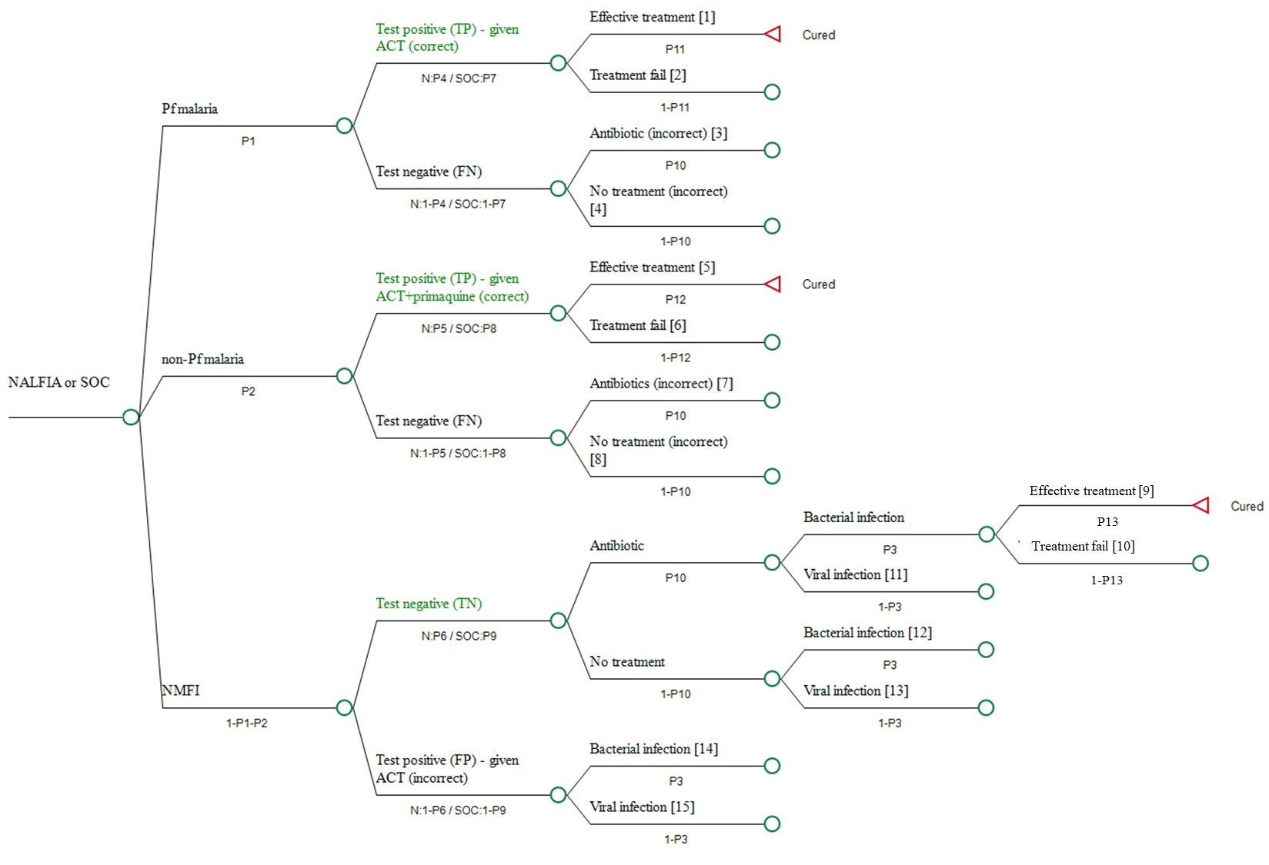
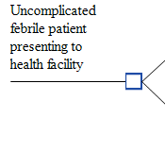

(1) Cost Effectiveness Analysis of a malaria diagnostic
An illustrative
decision tree
Courtesy of Dr Bryony Simmons

Slide 14
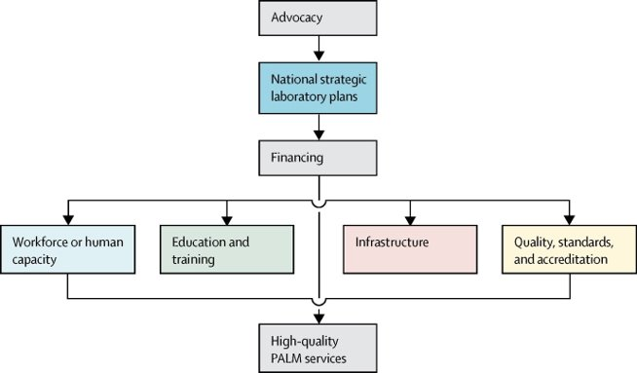
(2) Health systems Analysis
How does the health system support the...
Introduction
Implementation
Scale up
…..of a new diagnostic tool (NALFIA)?
*
*
pathology and laboratory medicine (PALM)
Fleming, K et al (2021) The Lancet Commission on diagnostics: transforming access to diagnostics.

Slide 15
Analytical Themes
1.Selection / introduction of diagnostic tools
2. Governance and Quality Assurance
3. Use of diagnostics (market characteristics)
4. Essential Diagnostics List (EDL)
5. Finance and Production of diagnostics
6. Human Resources
7. Impact of COVID-19
8. Utility of NALFIA
……..By National, Regional/ County, District and Facility Level
Health System Level | Ethiopia | Burkina Faso | Kenya | Namibia | Sudan | Totals
Facility (within and beyond trial) |  | 4 | 5 |  |  | 9
District |  | 1 | 1 | 5 |  | 7
Regional / County |  | 1 | 2 | 1 |  | 4
National |  | 3 | 2 |  |  | 5
Total so far | (4) | 9 | 10 | 6 | 0 | 25 (29)

Slide 16
National-Level Insights
Selection & Governance
Burkina Faso (BF): Primarily uses WHO pre-qualified RDTs funded by donors (e.g., USAID, Global Fund).
Kenya (KE): MoH & NMCP responsible; Kenya mandates its own validation—WHO prequalification alone not accepted.
Quality & Supply
BF: RDTs sometimes expire at facilities due to low turnover.
KE: Stockouts frequent, especially in high-burden regions like lake zones.
Conteh et al (in preparation): A multicountry health system analysis to understand the optimal introduction of a new point of care test

Slide 17
Use, EDL, and Financing
Use of Diagnostics
BF: Microscopy valuable but expensive and hard to maintain.
KE: RDTs are primary; PCRs used for surveys; microscopy in referral hospitals.
Essential Diagnostics List (EDL)
BF: No standardized EDL mentioned; local lists used inconsistently.
KE: Maintains a national EDL aligned with WHO, updated regularly.
Financing & Production
BF: Heavily donor-dependent.
KE: Mix of government and donor support; local manufacturing through KEMRI and Revital.

Slide 18
Human Resources & Subnational Trends
Workforce Capacity
BF: Unequal staff distribution; training strong but staff often move to research centers.
KE: High workload leads to burnout; retraining for microscopy common.
Namibia (N): MRDT capacity sufficient; more training needed for new tools.
Subnational Insights
Diagnostic decisions are top-down.
Stockouts common; equipment expiration less frequent.
Limited understanding of private sector roles and diagnostic costs across all countries.
MRTD – malaria rapid diagnostic test
Notes:
National-Level Perspectives
BF: Seen as promising but concerns over cost, time (2-hour runtime), and training.
KE: Valuable in referral hospitals for detecting hrp2-deletion cases and survey validation.
Regional / County-Level Feedback
BF: Questions on patient wait time, cost to patient, and acceptance by workers.
N: Concerns about supply chain, cost, and community acceptance. Sees value in detecting RDT false positives.
KE: NALFIA offers efficiency (14 tests/run) and time-saving for high-volume clinics.
Facility-Level Considerations
BF: Concern over test time during peak season.
KE: Lack of power backup is a barrier; cost to patient could hinder uptake.
N: No major barriers beyond need for training; praised for community-level potential

Slide 19
Macro economics:
Wider impact

Slide 20
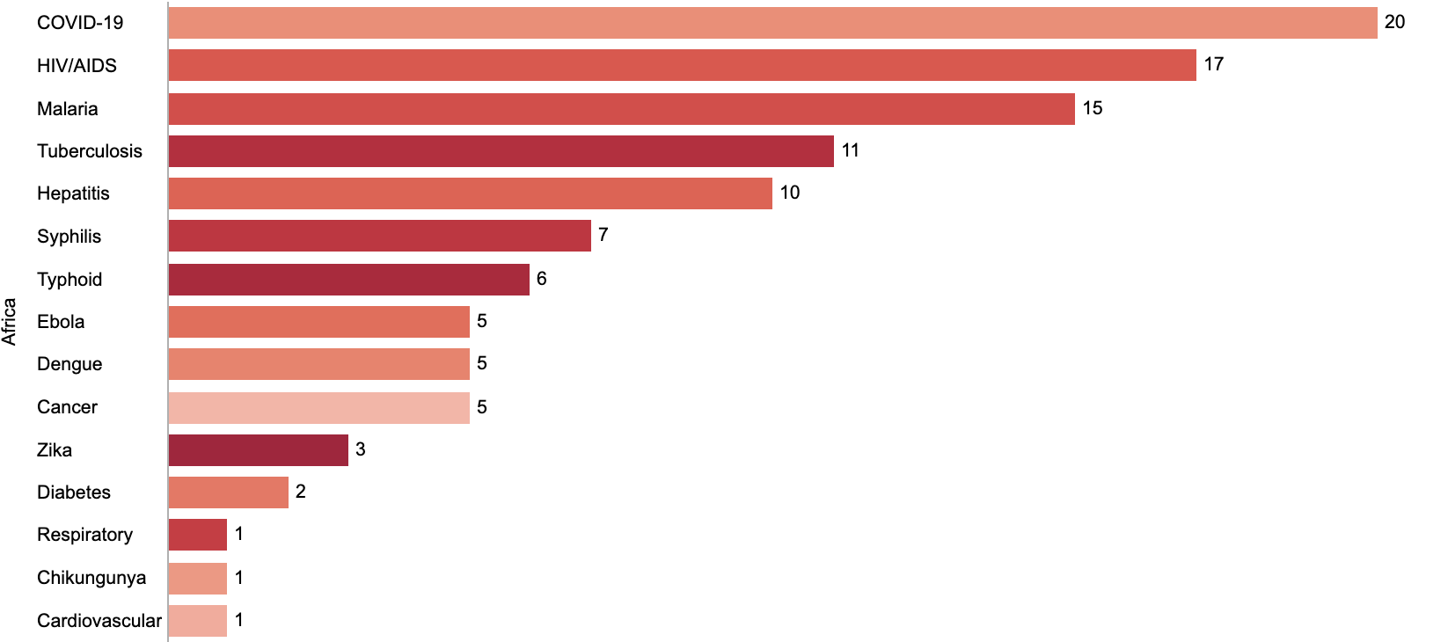
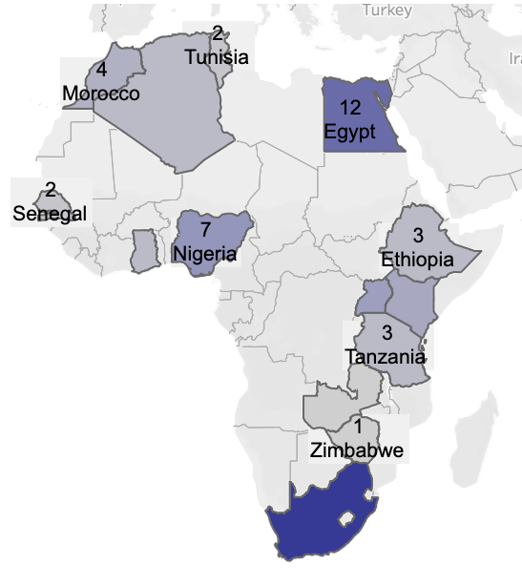
African Diagnostic Manufacturing Capabilities
Domestic manufacturing of diagnostics in Africa promotes:
Self-sufficiency
Job and skill creation
Local supply chains
Innovation
Economic growth
Addressing domestic healthcare priorities
Number of Diagnostic Companies with Local Manufacturing
& their Disease Focus
19
South
Africa
Path, Diagnostic Manufacturing Dashboard, 2022

Slide 21
Research overview
Perspective | Research Questions | Methods
Micro Obj1: Individual Preferences | Preferences for HIV, STI, Measles, Yellow Fever, Dengue and other selected POCTs | Focus group discussions, in-depth interviews, document reviews, cross-sectional surveys Discrete choice experiments
Meso Obj2. Decision criteria & priority setting Ob3: Availability & use of POCT Obj4: Economic & Impact Evaluations | Private sector role in delivery Pilot study: cancer screening and HIV & STI POCTs – towards a National roll out Cost Effectiveness of POCTs | Facility surveys, in-depth interviews, document reviews Thematic/content analysis, CEA, Impact evaluation
Macro Obj5: COVID-19 as a catalyst for change Obj6: Investment Cases | Investment case - investing in future domestic manufacturing Modelling health and economic benefits of national roll out of POCTs | In-depth interviews, document review, disease modelling Market analysis, case studies, network analysis

Slide 22












Thank you
Special thanks to Dr Bryony Simmons & Dr Elisa Sicuri
l.conteh@lse.ac.uk
Grant number 317468/Z/24/Z

